Slide 1
GROUP 9 CmpE 451

Slide 2
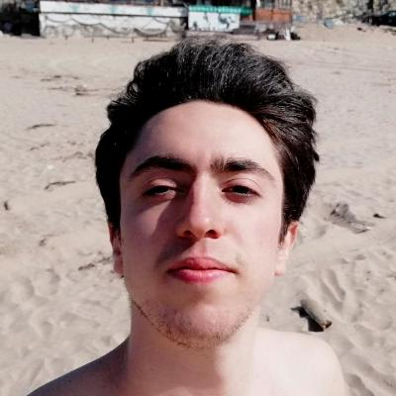
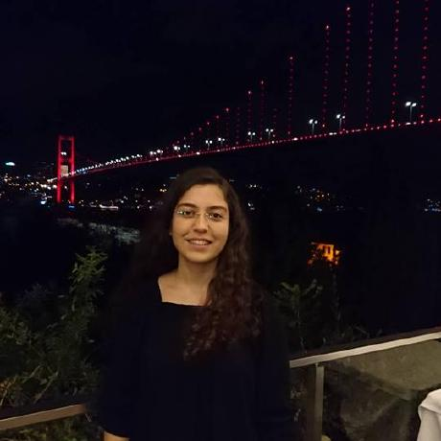
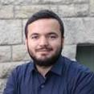
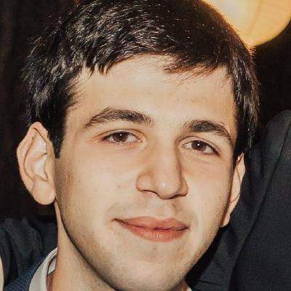
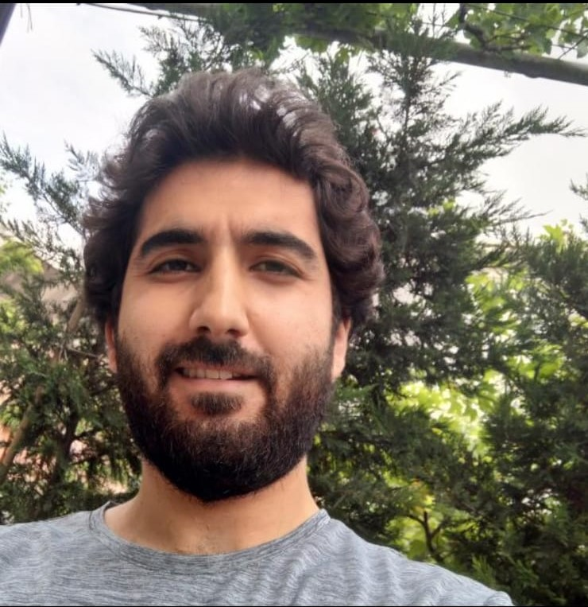
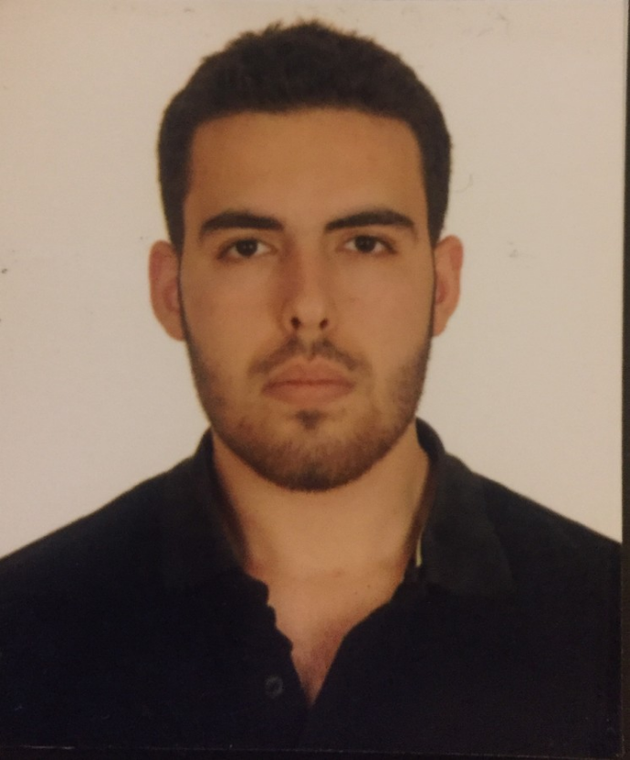
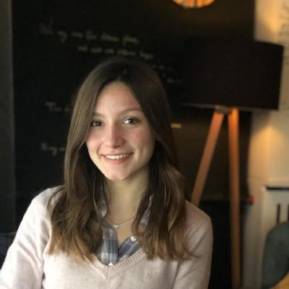
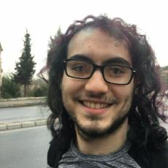
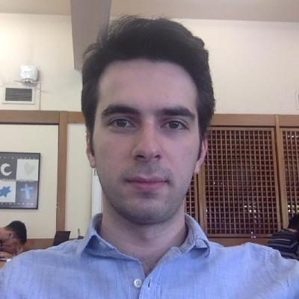
Who are we?
Egemen
Irem
Ibrahim
Arda
Gokhan
Ahmet
Emirhan
Gamze
Halit

Slide 3
Our Project in A Nutshell
Learning languages
Read, write, listen, chat and test yourself
Collaboration of learners
Mix of different cultures

Slide 4
Where are we right now?
How far did we come?
What did we achieve and what we could not?
What was hard in our way?

Slide 5
What awaits us in the future?
What are our plans in general?
What we have planned for the close future?
What we have learned and apply in the future?

Slide 6
THANKS ☺

